Slide 1
SPECIAL DISCRETE RANDOM VARIABLE

Slide 2
1.Discrete Uniform Distribution

Slide 3
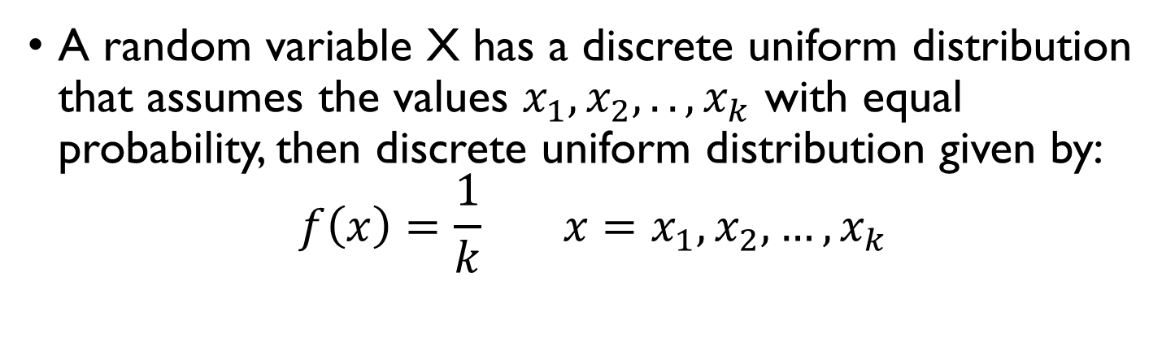
DEFINITION 1.1
A random variable X can take on k different values with equal probability, known as discrete uniform distribution.
DEFINITION 1.2
A random variable X has a discrete uniform distribution that assumes the values $x_{1}, x_{2},..,x_{k}$ with equal probability, then discrete uniform distribution given by:
$$f\left(x\right)=\frac{1}{k} x=x_{1},x_{2},…,x_{k}$$

Slide 4
Example 1
An employee is selected from a staff of 10 to supervise a certain project by selecting a tag at random from a box containing 10 tags numbered from 1 to 10. find the formula of the probability distribution of X representing the number on the tag that is drawn. What is the probability that the number drawn is less than 4?

Slide 5

MEAN and VARIANCE
MEAN
$$E\left(X\right)=μ=\frac{k+1}{2}$$
VARIANCE
$$σ^{2}=\frac{k^{2}−1}{12}$$

Slide 6
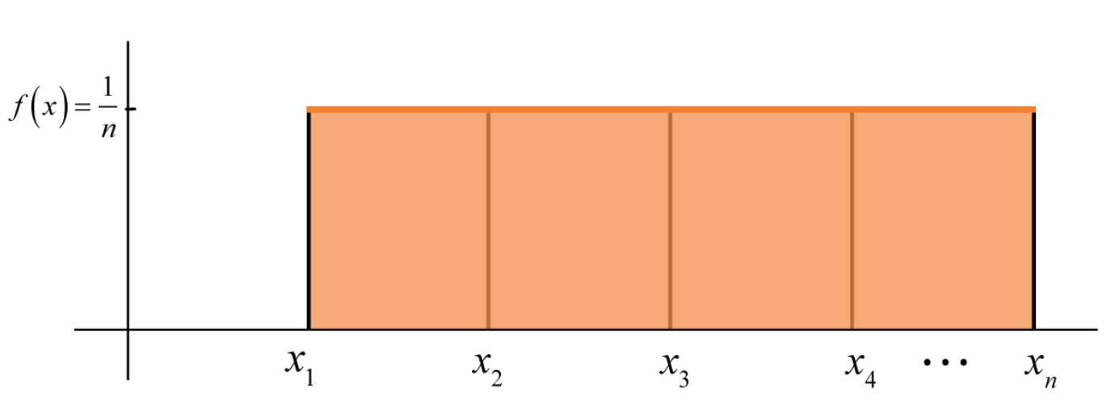
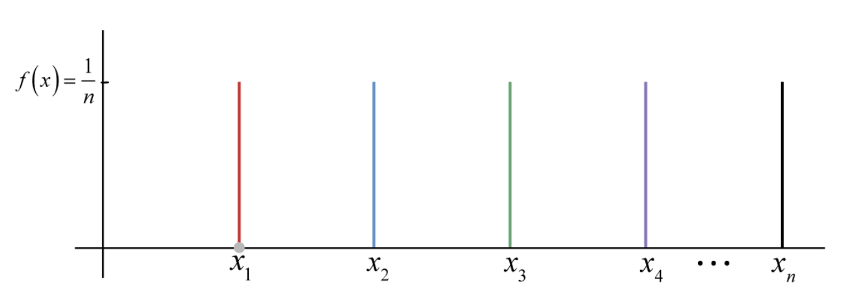
Example 2
Imagine a box of 12 donuts sitting on the table, and you are asked to randomly select one donut without looking. Each of the 12 donuts has an equal chance of being selected. Therefore, the probability of any one donut being chosen is the same or uniform.

Slide 7
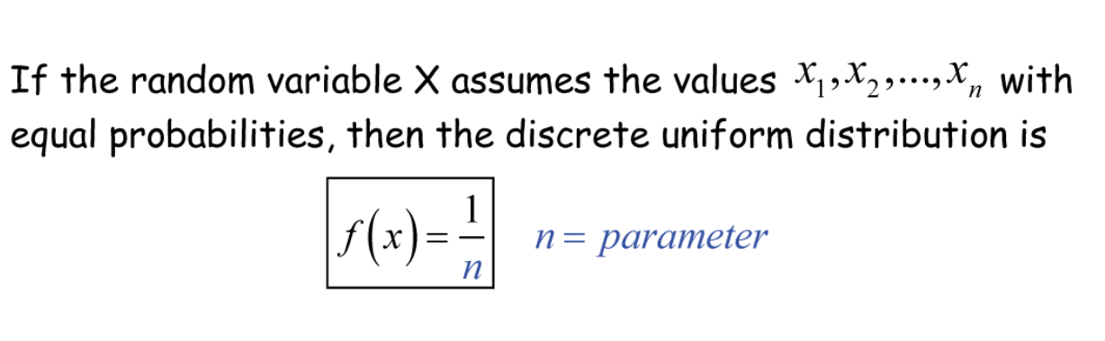

Calculate the mean and variance :
MEAN
$$E\left(X\right)=μ=\frac{12+1}{2}=6.5$$
VARIANCE
$$σ^{2}=\frac{{12}^{2}−1}{12}=11.9$$

Slide 8
2. Binomial Distribution

Slide 9
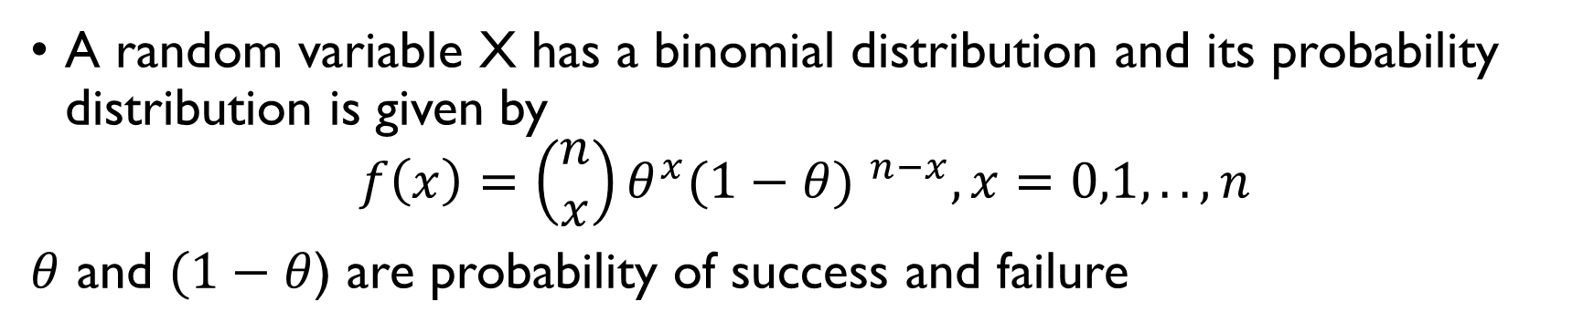
DEFINITION 2.1
The number X of successes in n Bernoulli trials is called a binomial random variable. The probability of this random variable is called the binomial distribution.
DEFINITION 2.2
A random variable X has a binomial distribution and its probability distribution is given by
$$f\left(x\right)=\left(\begin{aligned}n \\ x\end{aligned}\right)θ^{x}{(1−θ) }^{n−x}, x=0,1,..,n$$
$θ$ and $(1−θ$) are probability of success and failure

Slide 10
Example 1
One specialist medical doctor claims that 70% of those with lung cancer are chain smokers. If his claim is correct:
Find the probability that of 10 such patients recently admitted to a hospital, fewer half are chain smokers.
Find the probability that 20 such patients recently admitted to a hospital, more than 6 is chain smokers.

Slide 11

MEAN and VARIANCE
Mean=$μ=nθ$
Variance=$nθ(1−θ)$

Slide 12
3. GEOMETRIC DISTRIBUTION

Slide 13
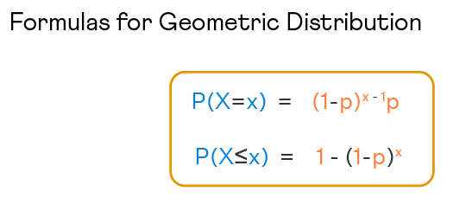
DEFINITION
Geometric distribution can be defined as a discrete probability distribution that represents the probability of getting the first success after having a consecutive number of failures.
A geometric distribution can have an indefinite number of trials until the first success is obtained.

Slide 14
MEAN & VARIANCE
Probability of success of a trial is denoted by p and failure is given by q.
A discrete random variable, X, that has a geometric probability distribution is represented as X∼G(p).
The mean of geometric distribution is also the expected value of the geometric distribution: E[X] = 1 / p
Variance can be defined as a measure of dispersion that checks how far the data in a distribution is spread out with respect to the mean: Var[X] = (1 - p) / p²

Slide 15
EXAMPLE 1
If a patient is waiting for a suitable blood donor and the probability that the selected donor will be a match is 0.2, then find the expected number of donors who will be tested till a match is found including the matched donor.
p = 0.2 E[X] = 1 / p = 1 / 0.2 = 5
The expected number of donors who will be tested till a match is found is 5 (including the donor).

Slide 16
EXAMPLE 2
Suppose you are playing a game of darts. The probability of success is 0.4. What is the probability that you will hit the bullseye on the third try?
p = 0.4 P(X = x) = (1 - p)^{x - 1}p P(X = 3) = (1 - 0.4)³ ⁻ ¹(0.4) P(X = 3) = (0.6)²(0.4) = 0.144

Slide 17
EXAMPLE 3
A light bulb manufacturing factory finds 3 in every 60 light bulbs defective. What is the probability that the first defective light bulb with be found when the 6th one is tested?
p = 3 / 60 = 0.05 P(X = x) = (1 - p)^{x - 1}p P(X = 6) = (1 - 0.05)⁶ ⁻ ¹(0.05) P(X = 6) = (0.95)⁵(0.05) P(X = 6) = 0.0386

Slide 18
4. HYPERGEOMETRIC

Slide 19
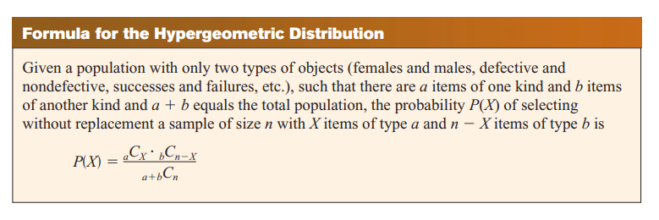
DEFINITION

Slide 20
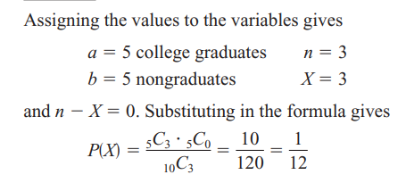
EXAMPLE 1
Ten people apply for a job as assistant manager of a restaurant. Five have completed college and five have not. If the manager selects 3 applicants at random, find the probability that all 3 are college graduates.

Slide 21
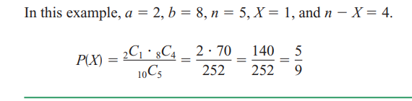
EXAMPLE 2
A recent study found that 2 out of every 10 houses in a neighborhood have no insurance. If 5 houses are selected from 10 houses, find the probability that exactly 1 will be uninsured.

Slide 22
5. POISSON DISTRIBUTION

Slide 23
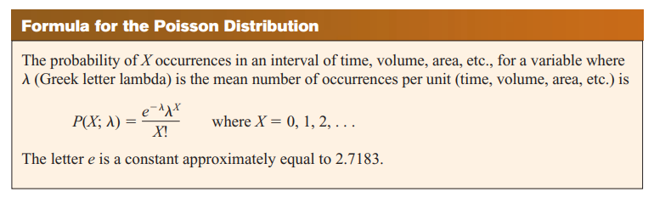
DEFINITION

Slide 24
The Poisson distribution formula is applied when there is a large number of possible outcomes.
For a random discrete variable X that follows the Poisson distribution, and λ is the average rate of value, then the probability of x is given by: f(x) = P(X=x) = (e^{-λ} λ^{x} )/x! where, x = 0, 1, 2, 3...
e is the Euler's number(e = 2.718)
λ is an average rate of the expected value and λ = variance, also λ>0

Slide 25
MEAN & VARIANCE
For Poisson distribution, which has λ as the average rate, for a fixed interval of time, then the mean of the Poisson distribution and the value of variance will be the same.
E(X) = V(X) = λ

Slide 26
EXAMPLE 1
In a cafe, the customer arrives at a mean rate of 2 per min. Find the probability of arrival of 5 customers in 1 minute using the Poisson distribution formula.
Given: λ = 2, and x = 5.
Using the Poisson distribution formula:
P(X = x) = (e^{-λ} λ^{x} )/x!
P(X = 5) = (e⁻² 2⁵ )/5!
P(X = 6) = 0.036
The probability of arrival of 5 customers per minute is 3.6%.

Slide 27
EXAMPLE 2
Find the mass probability of function at x = 6, if the value of the mean is 3.4.
Given: λ = 3.4, and x = 6.
Using the Poisson distribution formula:
P(X = x) = (e^{-λ} λ^{x} )/x!
P(X = 6) = (e^{-3.4} 3.4⁶ )/6!
P(X = 6) = 0.072
The probability of function is 7.2%.

Slide 28
EXAMPLE 3
If 3% of electronic units manufactured by a company are defective. Find the probability that in a sample of 200 units, less than 2 bulbs are defective.
The probability of defective units p = 3/100 = 0.03
Give n = 200.
We observe that p is small and n is large here. Thus it is a Poisson distribution.
Mean λ= np = 200 × 0.03 = 6
P(X= x) is given by the Poisson Distribution Formula as (e^{-λ} λ^{x} )/x!
P(X < 2) = P(X = 0) + P(X= 1)
=(e⁻⁶ 6⁰ )/0! + (e⁻⁶6¹ )/1!
= e⁻⁶ + e⁻⁶ × 6
= 0.00247 + 0.0148
P(X < 2) = 0.01727

Slide 29
EXERCISE
If there are 200 typographical errors randomly distributed in a 500-page manuscript, find the probability that a given page contains exactly 3 errors.
If approximately 2% of the people in a room of 200 people are left-handed, find the probability that exactly 5 people there are left-handed.
A lot of 12 compressor tanks is checked to see whether there are any defective tanks. Three tanks are checked for leaks. If 1 or more of the 3 is defective, the lot is rejected. Find the probability that the lot will be rejected if there are actually 3 defective tanks in the lot.

Slide 30
THE END

